Slide 1



Data Analysis for Social Buzz

Slide 2


Today's agenda
Project recap
Problem
The Analytics team
Process
Insights
Summary

Slide 3

“Social Buzz”, a rapidly expanding tech unicorn, faces the challenge of adapting to its swift global growth.
To address this, Accenture has initiated a three-month proof of concept (POC), aimed at optimizing key areas of business specifically on:
Conducting a comprehensive audit of your big data practices.
Developing tailored recommendations to ensure a seamless IPO.
Analyzing content data to identify the top five most popular categories, enabling more targeted content strategies.
Project Recap

Slide 4

Problem
Social Buzz's rapid global growth has outpaced its existing infrastructure, making it difficult to manage the vast amounts of unstructured data generated daily.
Over 100,000 pieces of content posted every day, the company’s current big data practices are stretched, leading to inefficiencies in analysis and management.
As Social Buzz prepares for an IPO, there’s an urgent need to streamline data operations and align business practices with industry best standards to attract investors.

Slide 5



Andrew Fleming
Chief Technology Architect
The Analytics team
Marcus Rompton
Senior Principal
Jemima Joannis
Data Analyst

Slide 6
Process
1
Data Access and Review
2
Data Cleaning and Merging
3
Data Modelling
4
Data Analysis and Insights
5
Visualization and Reporting

Slide 7

Insights
Unique Categories
Total reactions to most popular category
“Animals”
Month with the most posts
16
1897
January

Slide 8
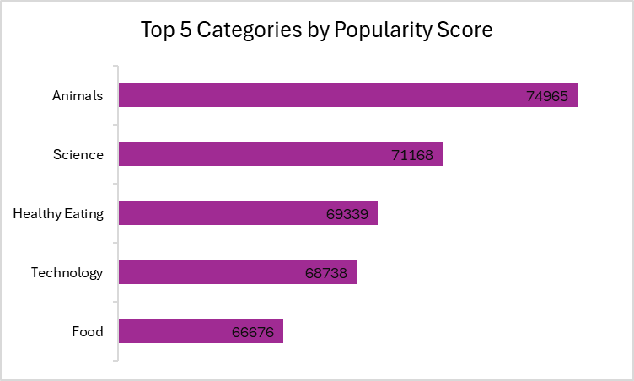

Slide 9
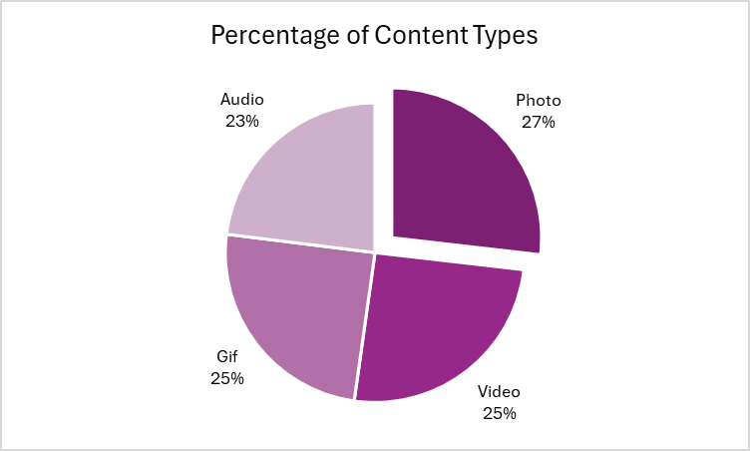

Slide 10

Animals and Science lead with the highest score, suggesting a preference for educational and enriching material that can engage curious and environmentally conscious individuals.
Healthy Eating and Food show there’s a strong interest in nutrition and culinary topics, suggesting a collective focus on health-consciousness and enjoyment of food-related content. Therefore, food-related challenges or recipe tutorials will encourage audience participation.
Technology maintains a strong position, signifying that your audience is tech-savvy, so you could create content that simplifies complex tech concepts.
We can continue to monitor audience preferences and trends by keeping track of shifts in engagement across the top categories, your team can adapt strategies such as content diversification to stay relevant in a changing digital landscape.
Summary

Slide 11
Thank you!
ANY QUESTIONS?

